Slide 1
Particle Photon Sparkfun Weather Shield and Microsoft Azure

Slide 2
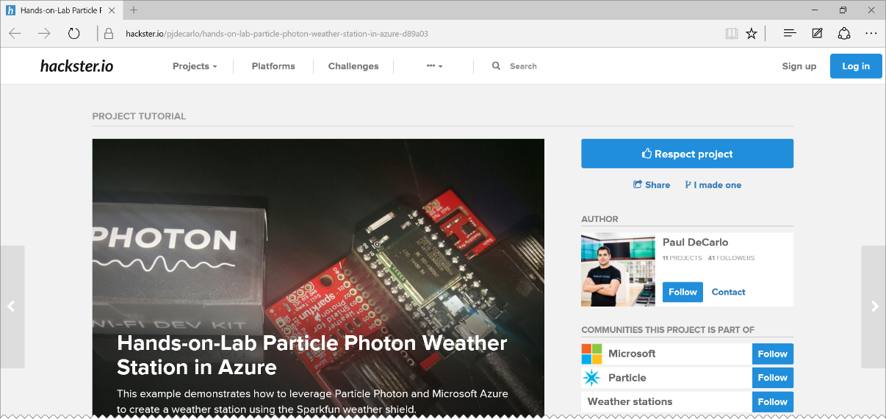
HANDS-ON-LAB WALKTHROUGH
http://aka.ms/pwshol
Go ahead and open it, but we’ll walk through it here.

Slide 3
Installing prerequisites

Slide 4
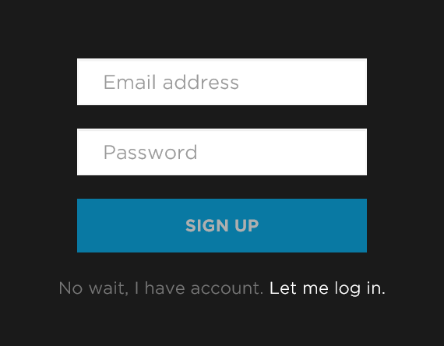
Create a free particle.io account
Go to http://particle.io
Click on the “build” link: http://build.particle.io/build
Create an account (free)

Slide 5
Install prerequisites
Install Node 0.12.4 (Yes, and older version) https://nodejs.org/download/release/v0.12.4/ Need a version manager for node? Check out https://github.com/creationix/nvm for Mac OSx or Linux or http://github.com/coreybutler/nvm-windows for Windows
Download and install Python 2.x (not 3+) https://www.python.org/downloads/
On Windows? You need Visual Studio C++ tools: http://aka.ms/msbuild2013
REBOOT AFTER

Slide 6
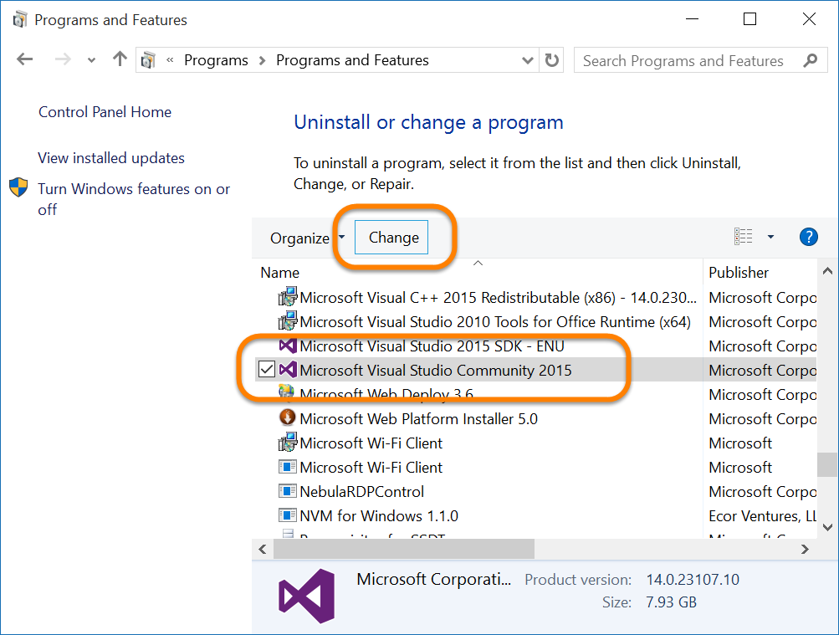
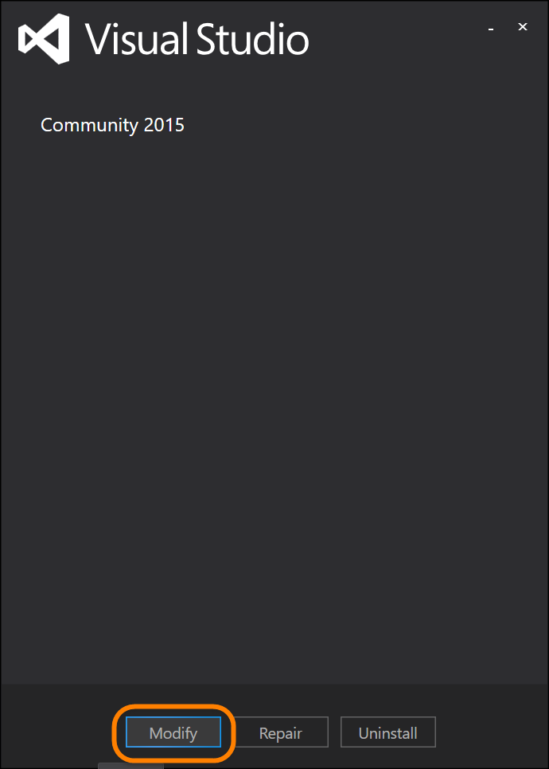
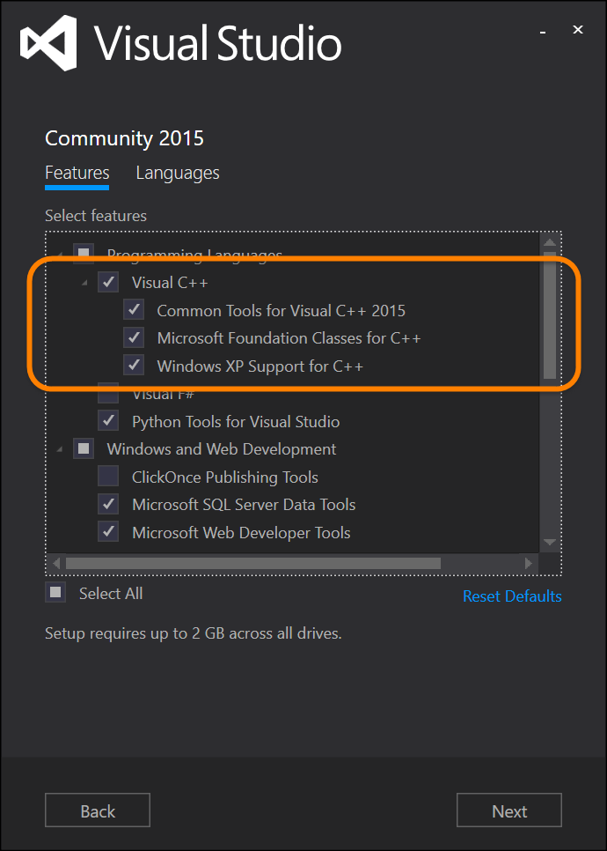
Windows C++ tools requirement
Already have VS installed, but not the C++ tools?
From “Control Panel” | “Programs” modify your VS install:

Slide 7
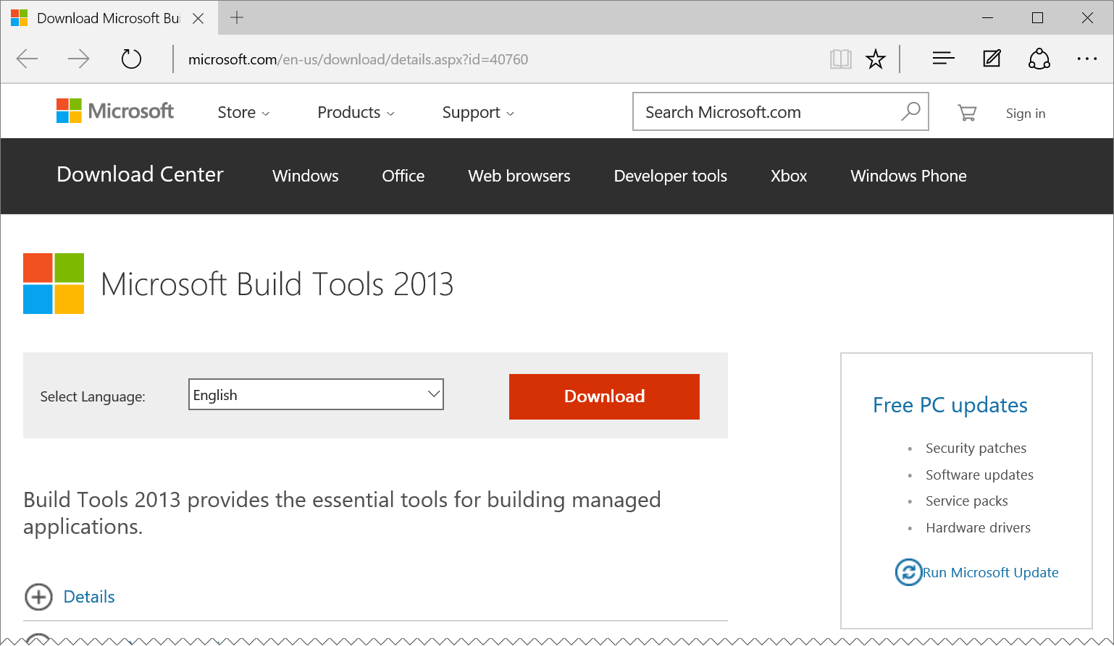
Windows C++ tools requirement
Don’t have Visual Studio installed?
Install MSBuild for VS2013: http://aka.ms/msbuild2013

Slide 8
Install the particle-cli
npm install particle-cli -g
If it doesn’t build right on Windows, try adding:
npm install particle-cli –g --msvs_version=2013

Slide 9
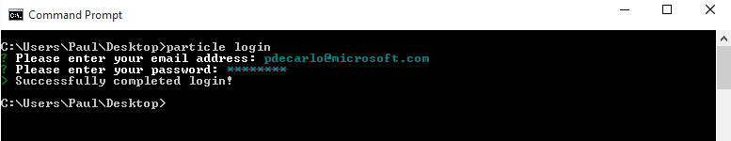
Login to the particle-cli
From a command prompt: particle login
Use the credentials for the particle account you created previously.

Slide 10
Setting up and claiming the photon

Slide 11
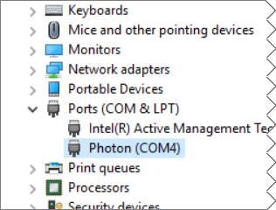
Connect the photon to your computer via usb cable
On Windows? Install the driver: http://aka.ms/photondriver
Extract the .zip file to a folder on your computer:
Open Device Manager
Right click-on the un-recognized device
Select “Update Driver Software…”
Point to the folder where you extracted the driver
Complete the install
Note the COM port it is attached to

Slide 12
Identify the attached photon
First find the COM port it is attached to: particle serial list
Then, get the device ID: particle serial identify
Copy the Photon ID to your clipboard and save somewhere for later

Slide 13
Configure the particle wifi
From the command prompt: particle serial wifi Follow the prompts to connect the WiFi: <your wifi ssid> <your wifi security mode> <your wifi cypher type> <your wifi password>

Slide 14
Claim and name your photon
Then, get the device ID, copy the reported ID to your clipboard (Make sure the Photon is in Listening Mode ): particle serial identify
Add the device to your account particle device add <id>
Name the device particle device rename <id> <newname>

Slide 15
Creating the webhook

Slide 16
Download the webhook.json
http://aka.ms/pwsholwebhook
Save it to a known folder on your computer
Open the webhook.json file to review it
YOU DO NOT NEED TO MAKE ANY CHANGES AT THIS POINT
Learn more about Particle Webhooks here: http://aka.ms/pwh

Slide 17
{
"event": "ConnectTheDots",
"url": "https://connectthedotsex-ns.servicebus.windows.net/ehdevices/messages",
"requestType": "POST",
"json": {
"subject": "{{s}}",
"unitofmeasure": "{{u}}",
"measurename": "{{m}}",
"value": "{{v}}",
"organization": "{{o}}",
"displayname": "{{d}}",
"location": "{{l}}",
"timecreated": "{{SPARK_PUBLISHED_AT}}",
"guid": "{{SPARK_CORE_ID}}"
},
"azure_sas_token": {
"key_name": "D1",
"key": "mBLQGWxSkRHg7f2eRCLonHUpNS+DY0iPHclxjf7Cmvk="
},
"mydevices": true
}

Slide 18
{
"event": "ConnectTheDots",
"url": "https://connectthedotsex-ns.servicebus.windows.net/ehdevices/messages",
"requestType": "POST",
"json": {
"subject": "{{s}}",
"unitofmeasure": "{{u}}",
"measurename": "{{m}}",
"value": "{{v}}",
"organization": "{{o}}",
"displayname": "{{d}}",
"location": "{{l}}",
"timecreated": "{{SPARK_PUBLISHED_AT}}",
"guid": "{{SPARK_CORE_ID}}"
},
"azure_sas_token": {
"key_name": "D1",
"key": "mBLQGWxSkRHg7f2eRCLonHUpNS+DY0iPHclxjf7Cmvk="
},
"mydevices": true
}
The name of the “event” that will invoke the webhook.
When you call Spark.publish("ConnectTheDots", payload); from your Photon, the Particle cloud back end will trigger this webhook and publish your payload to the Azure Event Hub, specified by the “url”

Slide 19
{
"event": "ConnectTheDots",
"url": "https://connectthedotsex-ns.servicebus.windows.net/ehdevices/messages",
"requestType": "POST",
"json": {
"subject": "{{s}}",
"unitofmeasure": "{{u}}",
"measurename": "{{m}}",
"value": "{{v}}",
"organization": "{{o}}",
"displayname": "{{d}}",
"location": "{{l}}",
"timecreated": "{{SPARK_PUBLISHED_AT}}",
"guid": "{{SPARK_CORE_ID}}"
},
"azure_sas_token": {
"key_name": "D1",
"key": "mBLQGWxSkRHg7f2eRCLonHUpNS+DY0iPHclxjf7Cmvk="
},
"mydevices": true
}
The “url” of the Azure Event Hub that the data will be published to.
In this case, we are posting to the “connectthedotsex-ns” service bus namespace into an event hub named “ehdevices”

Slide 20
{
"event": "ConnectTheDots",
"url": "https://connectthedotsex-ns.servicebus.windows.net/ehdevices/messages",
"requestType": "POST",
"json": {
"subject": "{{s}}",
"unitofmeasure": "{{u}}",
"measurename": "{{m}}",
"value": "{{v}}",
"organization": "{{o}}",
"displayname": "{{d}}",
"location": "{{l}}",
"timecreated": "{{SPARK_PUBLISHED_AT}}",
"guid": "{{SPARK_CORE_ID}}"
},
"azure_sas_token": {
"key_name": "D1",
"key": "mBLQGWxSkRHg7f2eRCLonHUpNS+DY0iPHclxjf7Cmvk="
},
"mydevices": true
}
The data will be sent to the url using an HTTP POST

Slide 21
{
"event": "ConnectTheDots",
"url": "https://connectthedotsex-ns.servicebus.windows.net/ehdevices/messages",
"requestType": "POST",
"json": {
"subject": "{{s}}",
"unitofmeasure": "{{u}}",
"measurename": "{{m}}",
"value": "{{v}}",
"organization": "{{o}}",
"displayname": "{{d}}",
"location": "{{l}}",
"timecreated": "{{SPARK_PUBLISHED_AT}}",
"guid": "{{SPARK_CORE_ID}}"
},
"azure_sas_token": {
"key_name": "D1",
"key": "mBLQGWxSkRHg7f2eRCLonHUpNS+DY0iPHclxjf7Cmvk="
},
"mydevices": true
}
The json template is used to create the data for the message that will be sent to the Azure Event Hub

Slide 22
{
"event": "ConnectTheDots",
"url": "https://connectthedotsex-ns.servicebus.windows.net/ehdevices/messages",
"requestType": "POST",
"json": {
"subject": "{{s}}",
"unitofmeasure": "{{u}}",
"measurename": "{{m}}",
"value": "{{v}}",
"organization": "{{o}}",
"displayname": "{{d}}",
"location": "{{l}}",
"timecreated": "{{SPARK_PUBLISHED_AT}}",
"guid": "{{SPARK_CORE_ID}}"
},
"azure_sas_token": {
"key_name": "D1",
"key": "mBLQGWxSkRHg7f2eRCLonHUpNS+DY0iPHclxjf7Cmvk="
},
"mydevices": true
}
{
“s”: ”wthr”,
“u”: “F”,
“m”: “Temperature”,
“v”: 79.234,
“o”: “WearHacks LA”,
“d”: “Brets Demo Photon” “l”: “LA”,
} Sample Payload from the Photon’s Spark.Publish call

Slide 23
{
"event": "ConnectTheDots",
"url": "https://connectthedotsex-ns.servicebus.windows.net/ehdevices/messages",
"requestType": "POST",
"json": {
"subject": "{{s}}",
"unitofmeasure": "{{u}}",
"measurename": "{{m}}",
"value": "{{v}}",
"organization": "{{o}}",
"displayname": "{{d}}",
"location": "{{l}}",
"timecreated": "{{SPARK_PUBLISHED_AT}}",
"guid": "{{SPARK_CORE_ID}}"
},
"azure_sas_token": {
"key_name": "D1",
"key": "mBLQGWxSkRHg7f2eRCLonHUpNS+DY0iPHclxjf7Cmvk="
},
"mydevices": true
}
The values:
SPARK_PUBLISHED_AT and SPARK_CORE_ID
Are supplied by the Particle cloud back end

Slide 24
{
"event": "ConnectTheDots",
"url": "https://connectthedotsex-ns.servicebus.windows.net/ehdevices/messages",
"requestType": "POST",
"json": {
"subject": "{{s}}",
"unitofmeasure": "{{u}}",
"measurename": "{{m}}",
"value": "{{v}}",
"organization": "{{o}}",
"displayname": "{{d}}",
"location": "{{l}}",
"timecreated": "{{SPARK_PUBLISHED_AT}}",
"guid": "{{SPARK_CORE_ID}}"
},
"azure_sas_token": {
"key_name": "D1",
"key": "mBLQGWxSkRHg7f2eRCLonHUpNS+DY0iPHclxjf7Cmvk="
},
"mydevices": true
}
The Shared-Access-Signature key name, and key value used to access the Azure Event Hub

Slide 25
{
"event": "ConnectTheDots",
"url": "https://connectthedotsex-ns.servicebus.windows.net/ehdevices/messages",
"requestType": "POST",
"json": {
"subject": "{{s}}",
"unitofmeasure": "{{u}}",
"measurename": "{{m}}",
"value": "{{v}}",
"organization": "{{o}}",
"displayname": "{{d}}",
"location": "{{l}}",
"timecreated": "{{SPARK_PUBLISHED_AT}}",
"guid": "{{SPARK_CORE_ID}}"
},
"azure_sas_token": {
"key_name": "D1",
"key": "mBLQGWxSkRHg7f2eRCLonHUpNS+DY0iPHclxjf7Cmvk="
},
"mydevices": true
}
Restricts the webhook to being triggered only from events published from your own devices

Slide 26
Create the particle webhook
From the command prompt, get in the same folder as the webhook.json file you downloaded, and run: particle webhook create webhook.json
Other particle-cli webhook commands include: particle webhook list particle webhook delete hookid

Slide 27
Programming the photon

Slide 28
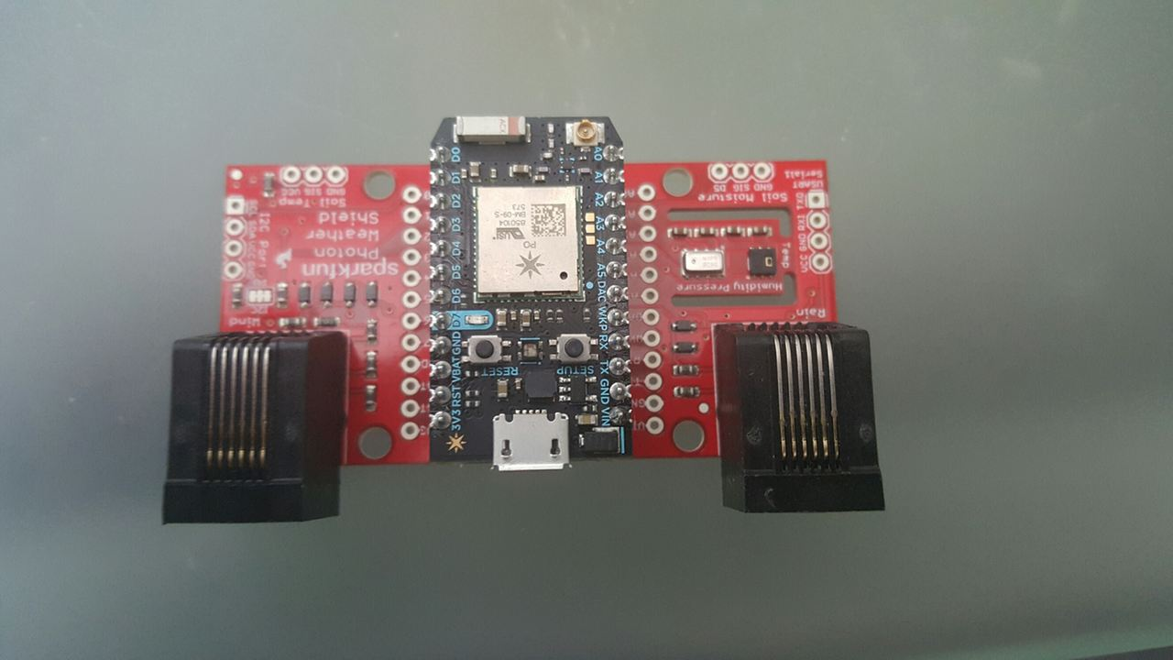
Assemble the photon and weather shield

Slide 29
Create the particleweathershield Sketch
Create a new “App” here: https://build.particle.io/build/new
Name it “ParticleWeatherShield”
Download the sketch from: http://aka.ms/pwsholsketch
Copy the text from the downloaded ParticleWeatherShield.ino file
Paste into the ParticleWeatherShield app in Particle Build

Slide 30


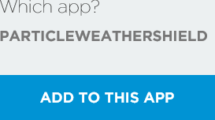
Add the Weather Shield library
In the Particle Build web interface, click the “Libraries” icon
Search for the SparkFun_Photon_Weather_Shield_Library
Select it, and then click the “INCLUDE IN APP” button:
Then, select the “ParticleWeatherShield” app, and click the “ADD TO THIS APP” button

Slide 31
Library include and fields
// This #include statement was automatically added by the Particle IDE.
#include "SparkFun_Photon_Weather_Shield_Library/SparkFun_Photon_Weather_Shield_Library.h"
Weather sensor;
char Org[] = "WearHacks LA";
char Disp[] = "Brets Demo Photon";
char Locn[] = "LA";

Slide 32
Setup method
void setup()
{
Serial.begin(9600);
sensor.begin();
sensor.setModeBarometer();//Set to Barometer Mode
sensor.setOversampleRate(7); // Set Oversample rate
sensor.enableEventFlags(); //Necessary register calls to enble temp, baro ansd alt
}

Slide 33
Loop method, and sensor reading
void loop()
{
// Measure Relative Humidity from the HTU21D or Si7021
float humidity = sensor.getRH();
// Measure Temperature from the HTU21D or Si7021
float tempf = sensor.getTempF();

Slide 34
Publish temperature data
delay(5000);
char payload[255];
snprintf(payload, sizeof(payload), "{
\"s\":\"wthr\",
\"u\":\"F\",
\"l\":\"%s\",
\"m\":\"Temperature\",
\"o\":\"%s\",
\"v\": %f,
\"d\":\"%s\" }", Locn, Org, tempf, Disp);
Spark.publish("ConnectTheDots", payload);
Serial.println(payload);
Sample Payload
{
“s”: ”wthr”,
“u”: “F”,
“l”: “LA”,
“m”: “Temperature”,
“o”: “WearHacks LA”,
“v”: 79.234,
“d”: “Brets Demo Photon” }

Slide 35
Publish humidity data, end loop
delay(5000);
snprintf(payload, sizeof(payload),
"{ \"s\":\"wthr\",
\"u\":\"%%\",
\"l\":\"%s\",
\"m\":\"Humidity\",
\"o\":\"%s\",
\"v\": %f,
\"d\":\"%s\" }", Locn, Org, humidity, Disp);
Spark.publish("ConnectTheDots", payload);
Serial.println(payload);
}
Sample Payload
{
“s”: ”wthr”,
“u”: “%”,
“l”: “LA”,
“m”: “Humidity”,
“o”: “WearHacks LA”,
“v”: 33,
“d”: “Brets Demo Photon” }

Slide 36
Modify the metadata properties
Put your own values in. Make sure that the “Display Name” is appropriate and identifies your Photon clearly: char Org[] = "ORGANIZATION_NAME"; char Disp[] = "DISPLAY_NAME"; char Locn[] = "LOCATION";

Slide 37



Save, verify and flash
Click the save icon to save your sketch:
Click the verify icon to compile and verify:
Click the flash icon to deploy your sketch:

Slide 38
Monitoring your photon

Slide 39
Monitor your photon
From the command prompt, to monitor all events or just a single event: particle subscribe mine or particle subscribe {webhook event name, eg “ConnectTheDots”}
To monitor the Serial output from a photon attached to your pc: particle serial monitor <COMPORT>
To see events in the particle.io dashboard, go to: https://dashboard.particle.io/user/logs
To see the data values coming in to the pre-made “ConnectTheDots” site: http://aka.ms/pwsholweb

Slide 40
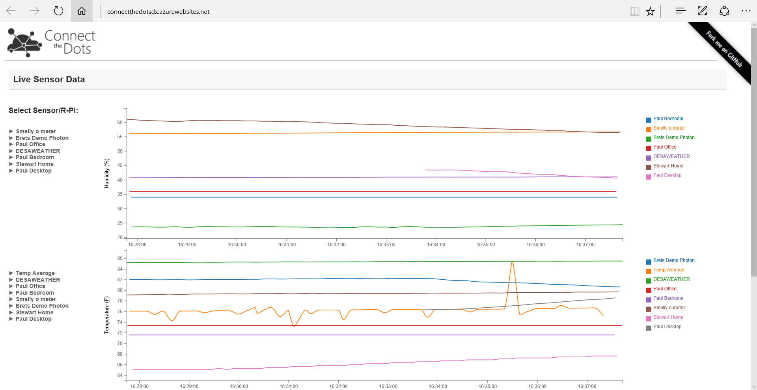
http://aka.ms/pwsholweb
Click device names along the left to show or hide them in the graphs

Slide 41
Where to go from here?
Publish other sensor values
Create your OWN event hubs and consume the data you publish
Create an Azure Subscription using the Free Trial, or see me for an Azure Pass
Create your own Event Hubs in Azure: http://aka.ms/ctdazureprep
Create your own ConnectTheDots dashboard web site: http://aka.ms/ctdazuresite
Learn about other ways to consume the data from the ConnectTheDots samples: http://connectthedots.io

Slide 42
resources:
This deck, and other event resources: http://aka.ms/whla
Info about Particle and Azure: https://www.particle.io/microsoft
Azure Documentation http://azure.microsoft.com
Azure Portal https://manage.windowsazure.com and https://portal.azure.com
Particle Documentation http://docs.particle.io

Slide 43
IoT Logo

Slide 44
arduino

Slide 45
GALILEO BOARD

Slide 46
LEDs

Slide 47
Resistors
220Ω
1st Digit
2nd Digit
Multiplier
Tolerance
Color | Name | 1st Digit | 2nd Digit | Multiplier | Tolerance
 | Black | 0 | 0 | X1
 | Brown | 1 | 1 | X10 | 1%
 | Red | 2 | 2 | X100
 | Orange | 3 | 3 | X1,000
 | Yellow | 4 | 4 | X10,000
 | Green | 5 | 5 | X100,000
 | Blue | 6 | 6 | X1,000,000
 | Violet | 7 | 7
 | Grey | 8 | 8
 | White | 9 | 9
 | Gold |  |  | X0.1 | 5%
 | Silver |  |  | X0.01 | 10%
330Ω
10KΩ

Slide 48
cables

Slide 51
Micro SD Cards
Font: Segoe UI Semibold

